Slide 1
University of Iowa Parental Leave Survey Report
March 31, 2017
Prepared for the Council on the Status of Women
By Sarah K. Bruch, Hansini Munasinghe, and Yujia Lyu

Slide 2
About the survey
Goal: Understand experiences and perceptions around parental leave at the University of Iowa
Online survey was sent out to University of Iowa faculty and staff in Spring 2016
Questions about:
Employment information
Parental status and demographic information
Types of leave
Satisfaction with leave, negotiation process, return to work, and pregnancy
Department and university climate around parental leave
Expected changes at department/unit and university level

Slide 3
Data Analysis
Overall experience, satisfaction and climate
Analysis of group differences for each outcome, by:
Gender
Race
Parental Status
Staff/Faculty
Faculty Tenure Status
College or Organizational Unit
Common themes in experiences, climate, and recommendations for change

Slide 4
Response rate
Overall, 2512 people responded to the survey
1978 individuals reached the final set of questions of the survey
As respondents could skip questions, the response rate of each question varies, leading to some missing data

Slide 5
Sample Representativeness
 |  | University Population | Survey Sample
Employment Status | Staff | 86% | 81%
 | Faculty | 14% | 19%
Gender | Men | 36% | 19%
 | Women | 64% | 81%
Race/Ethnicity | White | 88% | 92%
 | Non-White | 12% | 8%

Slide 6
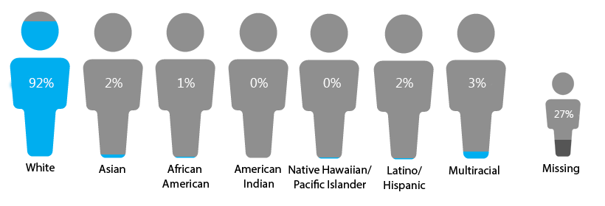
Survey Demographics
Race
Survey contained two questions that asked respondents to self-identify their race and Latino/a ethnicity. These questions were combined to create the above racial/ethnic categories.

Slide 7
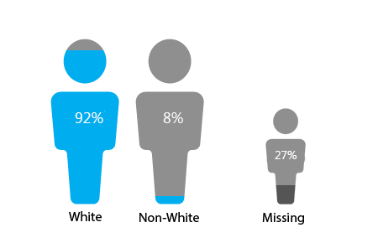
Survey Demographics
Race - recoded

Slide 8
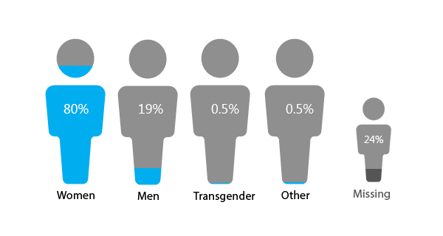
Survey Demographics
Gender

Slide 9
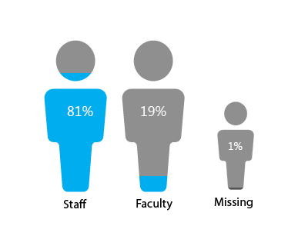
Survey Demographics
Employment Status

Slide 10
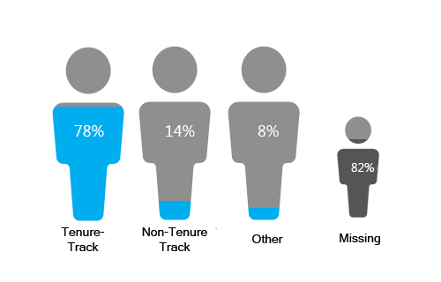
Survey Demographics
Faculty Status

Slide 11
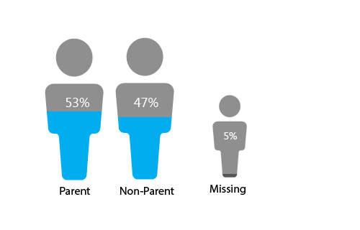
Survey Demographics
Parental Status
“Are you the parent of a child who joined your family through birth or adoption since 1993 (the year that the FMLA was enacted)?”

Slide 12
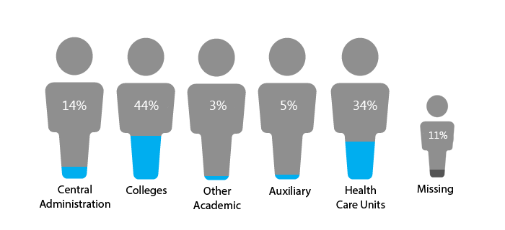
Survey Demographics
Colleges and Organizations

Slide 13
Parental Leave experience subsample

Slide 14
Experiences
Type of Leave | Requested | Received
Family Medical Leave Act (FMLA) | 67% | 92%
Paid leave (accrued sick or vacation leave) | 73% | 96%
Unpaid leave | 10% | 85%
Adaptation to employment duties and/or schedule | 5% | 71%
Automatic tenure-clock extension | 3% | 85%
Reduced appointment | 3% | 81%
Flexible work arrangements | 8% | 87%
Catastrophic leave | 4% | 80%
Family caregiving leave | 13% | 79%
Other forms of leave | 2% | *

Slide 15
SATISFACTION
Satisfaction with Leave Received: “How satisfied are you with the leave and/or accommodations that you received?”
Satisfaction with Process: “How satisfied are you with the process of requesting and negotiating parental leave?”
Satisfaction with Return: “How satisfied were you with your return to work after your parental leave?”
Satisfaction with Pregnancy: “If you are a birthmother, how satisfied were you with your experience on the job during your pregnancy?”

Slide 16
SATISFACTION
Tenure-Track > Non-Tenure Track (9%)
Central Administration > Colleges (19%)
Central Administration > Other Academic (26%)
Central Administration > Health Care Units (12%)
Staff > Faculty Member (19%)
Central Administration > Colleges (17%)
Central Administration > Health Care Units (14%)
White > Non-White (19%)
Staff > Faculty Member (11%)

Slide 17
SATISFACTION

Slide 18
DISSATISFACTION – Received Leave
 | Percentage
Parental leave was not long enough | 30%
Hope the university can provide paid leave | 24%
Information about parental policy was not clear, standardized and hard to access | 19%
The climate was not supportive | 14%
Fathers and adoptive family were either denied leave or had little leave | 11%

Slide 19
DISSATISFACTION – Received Leave
“I would have liked to have more time with my baby, especially given the extra issues, but I had only been here 18 months and hadn't accrued enough sick/vacation to cover a longer leave, and unfortunately unpaid leave wasn't an option due to my sole family income. It's time I'll never get back with my baby, let alone the stress of it all, and working with lack of sleep.”

Slide 20
DISSATISFACTION – Negotiation process
 | Percentage
The information about policy was confusing and inconsistent | 40%
No negotiation or unpleasant negotiation process (inefficient paper work, etc.) | 23%
The climate was not supportive | 17%
Unfair treatment for some groups | 6%
Should not have to negotiate | 4%

Slide 21
DISSATISFACTION – Negotiation process
“I wish that my supervisor and/or HR rep had taken a more active approach to explaining all of the options available to me so that I could make a fully informed choice. I had no idea what was available and what would work best for me: no advocate on my behalf.”
“I am afraid to ask as I will look like I don't want to do my work.”

Slide 22
DISSATISFACTION – Return to work
 | Percentage
Early return or interruptions from work during leave | 40%
Lack of accommodation for breastfeeding and transition | 31%
Penalty for taking parental leave | 23%
Other experiences (e.g. inconsistent information, overall dissatisfaction) | 6%

Slide 23
DISSATISFACTION – Return to work
“I returned too early, felt pressured not to talk about the baby, felt I needed to work twice as hard as everyone else to "catch up".... Like I had been on a vacation or something. Was still pumping, not adequate protections for lactation, was still recovering from surgery. It was just too early. I thought we were better than that.”

Slide 24
DISSATISFACTION – Pregnancy and work
 | Percentage
The climate was not supportive | 49%
Physical difficulties (fatigue, discomfort, contractions and other pain, etc.) | 26%
Lack of accommodation for different needs (breastfeeding, work, etc.) | 23%

Slide 25
DISSATISFACTION – Pregnancy and work
“I was sick for most of my pregnancy, including blacking out, but asking for time off without losing my job seemed impossible.”
“I was expected to work until the day I gave birth. I had high blood pressure and a complicated pregnancy and I could not get any leave. I was timing contractions during faculty meetings. This was all completely against my will.”

Slide 26
Other Experiences
Is there anything else you would like to share about your experience with requesting parental leave for any birth or adoption while employed at the University of Iowa?

Slide 27
Other Experiences
 | Percentage
Satisfaction | 42%
Good combination of options and enough time (12 weeks)
Flexible working schedule
Informative HR or supervisor
Supportive HR, supervisors and colleagues
Dissatisfaction | 58%
Leave was not long enough (usually less than 12 weeks)
Inflexible working schedules
Information about policy was not clear or consistent
Pressure from work and other people
Unfair treatment for different groups

Slide 28
Climate Measures
Colleague Supportiveness: "Overall, my colleagues are very supportive when I have a family issue to take care of.“
Chair Supportiveness: "My department or unit chair is mindful of scheduling courses and meetings to accommodate employees with child care responsibilities."

Slide 29
Colleague and chair supportiveness
Men > Women (4%)
Parent > Non-Parent (9%)
Central Administration > Health Care Units (12%)
Colleges > Health Care Units (5%)
Other Academic > Health Care Units (12%)
Men > Women (6%)
Parent > Non-Parent (12%)
Central Administration > Health Care Units (7%)
Colleges > Health Care Units (8%)
Other Academic > Health Care Units (17%)

Slide 30
Climate Measures
Perceived Practice Fairness: "Do you perceive that other people in your department or unit have been treated more favorably than others with regard to parental leave?”
General Department/Unit Climate: "How would you describe the climate surrounding parental leave in your department or unit?”
General University Climate: "How would you describe the climate surrounding parental leave in the university more generally?”

Slide 31
Staff > Faculty Member (9%)
White > Non-White (13%)
Tenure-Track > Non-Tenure Track (18%)
Central Administration & Auxiliary > Colleges (12%)
Central Administration & Auxiliary > Other Academics (13%)
Central Administration & Auxiliary > Health Care Units (13%)
General Climate (Dept/unit, univ, fairness)
Men > Women (8%)
Parent > Non-Parent (9%)
Central Administration & Other Academic > Colleges (7% & 15%)
Central Administration & Other Academic > Health Care (8% & 16%)
Staff > Faculty Member (11%)
White > Non-White (14%)
Central Administration > Colleges (10%)
Central Administration > Health Care Units (13%)

Slide 32
Why is climate poor?
Department/Unit Climate | Percentage
Expectation of choosing work over family | 43%
Colleagues’ pressure or lack of awareness | 23%
Current policy was bad or badly implemented | 20%
Some departments/units were supportive while others were not | 9%
Other reasons (e.g. worker shortage, lack of women leaders) | 5%
University Climate | Percentage
Expectation of choosing work over family | 13%
Lack of understanding of family and pregnancy | 15%
Current policy was unsatisfying or badly implemented | 59%
Negative impression from anecdotes | 13%

Slide 33
Why is climate poor?
“I am surrounded by single and child free coworkers. Though they think they are supportive, they simply make certain assumptions that make me feel pressure to not take time to care for my child.”
“There is no leave policy beyond FMLA, so few people get the leave that all new parents deserve, and there is inequity between individuals based on who has a chair that is sympathetic AND good at negotiating on their faculty’s behalf.”

Slide 34
Why the practices were unfair?
 | Percentage
Favoritism and unfair treatment | 27%
Policy implementation was dependent on supervisor | 31%
Some groups were treated differently or discriminated against | 42%

Slide 35
Why the practices were unfair?
“I know that there was a woman who had a child before me in the unit. She couldn’t make a decision on whether she wanted to come back after she had her child. She came back after for a short time, but then decided to leave. This seemed to set the tone for how I was treated… my supervisor, I think she thought all moms would be like the example she had seen. So, this first mom was allowed to come back part-time. I was never given this chance – even though (as my boss says) I ‘begged for it’.”

Slide 36
Climate Measures
Perceived Career Pressure: "The career pressures I experience here have caused me to miss many important events in my family and personal life."

Slide 37
Perceived Career Pressures
Faculty Member > Staff (9%)
Tenure-Track > Non-Tenure Track (17%)
Colleges & Health Care Units > Central Administration (9%&15%)
Colleges & Health Care Units > Auxiliary (5% & 11%)

Slide 38
Climate Measures
Policy Influence on Recruitment: "To what extent did your college's policies or department's practices around parental leave affect your retention in your department or unit?“
Policy Influence on Retention: "To what extent did your college's policies or department's practices around parental leave affect your retention in your department or unit?"

Slide 39
Influence on Career (recruitment & retention)
Faculty Member > Staff (4%)
Men > Women (9%)
White > Non-White (8%)
Non-Parent > Parent (14%)
Men > Women (4%)
White > Non-White (16%)
Non-Parent > Parent (7%)

Slide 40
Expected Changes
 | Percentage
Policy Improvements | 40%
Offer paid leave
Offer short-term disability
Secure 12-week parental leave for each person, not shared by family
Standardized implementation
Information Disclosure Improvements | 17%
Provide more accurate, clear information and easy access to it
Offer information sessions for parents, HR and supervisors
Provide uniform interpretation of the policy

Slide 41
Expected Changes
 | Percentage
Before & After Leave Accommodation Improvements | 34%
Provide accommodation during and after pregnancy and other parents (help with lifting, breastfeeding, parking, on-site day care, etc.)
Provide more flexible working schedule (half-time, 75% time, etc.)
Provide job coverage (e.g. hire temporary workers)
Let people donate time to those who need
Climate Improvements | 9%
Achieve better and more inclusive environment
No parenthood penalty

Slide 42
Conclusion
Survey results suggest both broad patterns and significant experiential
or perceptual differences across demographic groups and University units.
Despite common institutional and statutory commitments, a significant share of respondents reported:
variation in expressed satisfaction with their own experience
confusion surrounding leave policies
inconsistent treatment across units
and unsupportive (and in some instances) punitive climates faced by parents requesting leave, taking leave, or returning from leave.

Slide 43
Conclusion
Overview of parental leave utilization, practices, and policies at the University of Iowa.
detail experience of parental leave
assessment of that experience
assessment of the campus climate surrounding parental leave
identify improvements of policies and practices surrounding parental leave

Slide 44
Questions?

Slide 45
Future Directions:
Reaching out to and encouraging the participation of underrepresented populations, including non-white racial and ethnic groups, and trans and other gender identities.
Making it clear in the survey distribution that survey is interested in the experiences and perceptions of both parents and non-parents.
Making open-ended questions available to respondents with both positive and negative experiences would lead to more detailed qualitative analysis.
Finally, many themes emerging in the current qualitative analysis may be important to specifically assess in future surveys. For example,
discrimination and retaliation
access to lactation facilities and other accommodations
experiences of fathers and adoptive parents

